Slide 1



Project Presentation: D8 News Summarizer & Bias Detector
Author: Ayush Yadav
Created with Pi

Slide 2

CONTENTS
1. Introduction
2. Tools Used
3. Implementation Workflow
4. Challenges Faced
5. Conclusion

Slide 3

01
Introduction

Slide 4
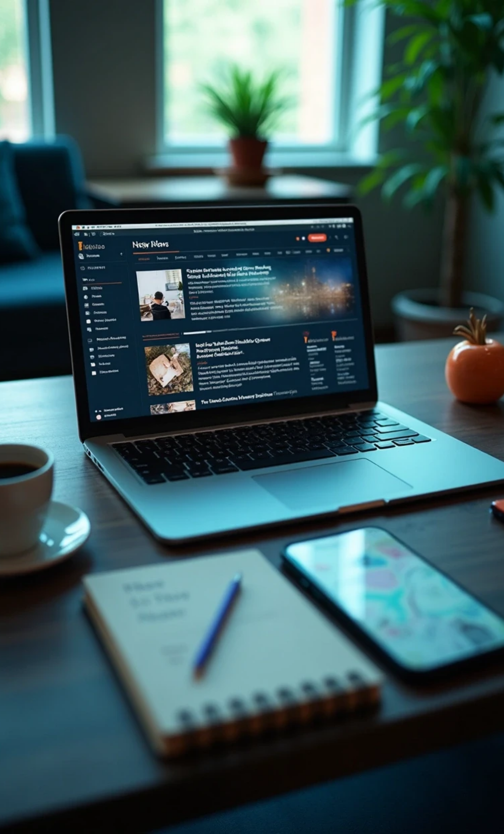
About the Project
The project is named "D8 News Summarizer & Bias Detector". It aims to summarize news articles and detect bias in the content provided by users.

Slide 5
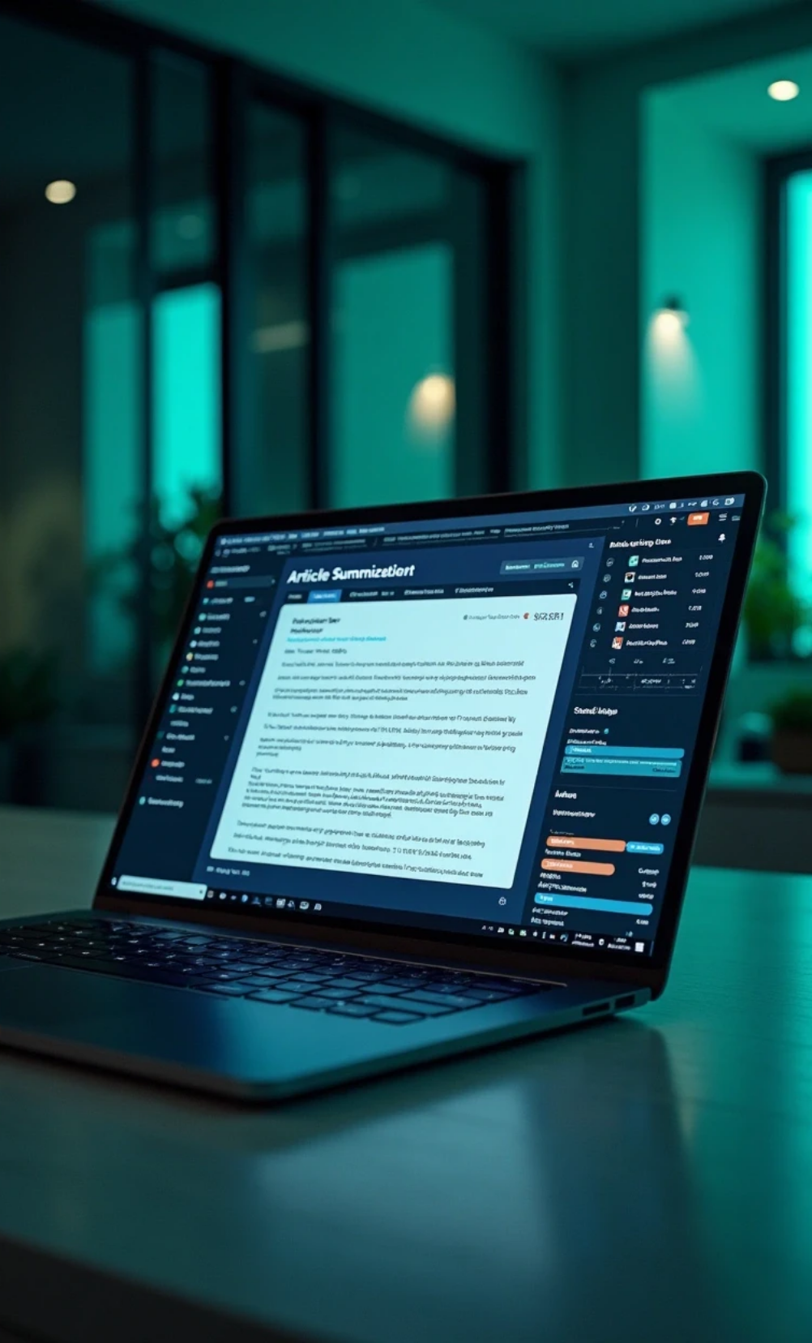

Objectives
1
To create a user-friendly interface for summarizing articles.
2
To implement bias detection algorithms.
3
To provide insights into the bias of different news sources.

Slide 6
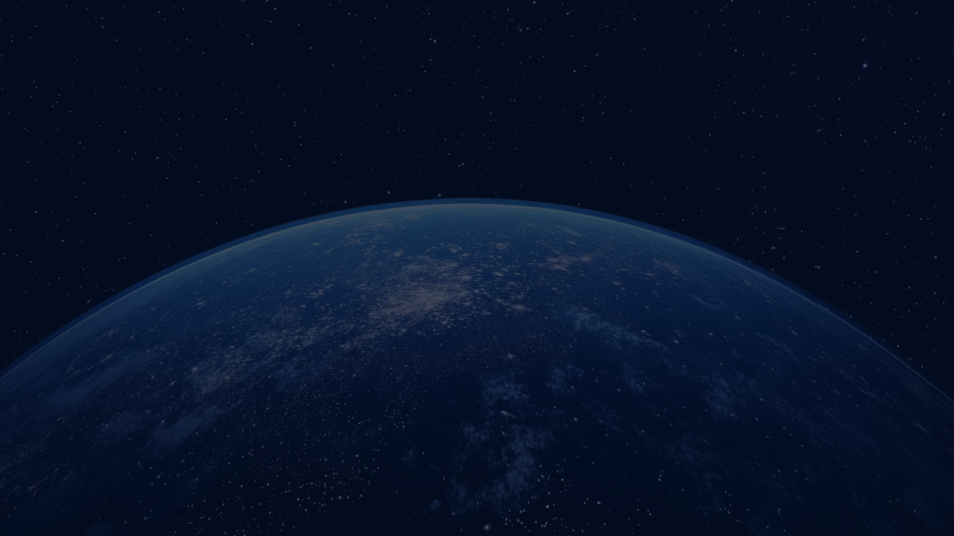
02
Tools Used

Slide 7
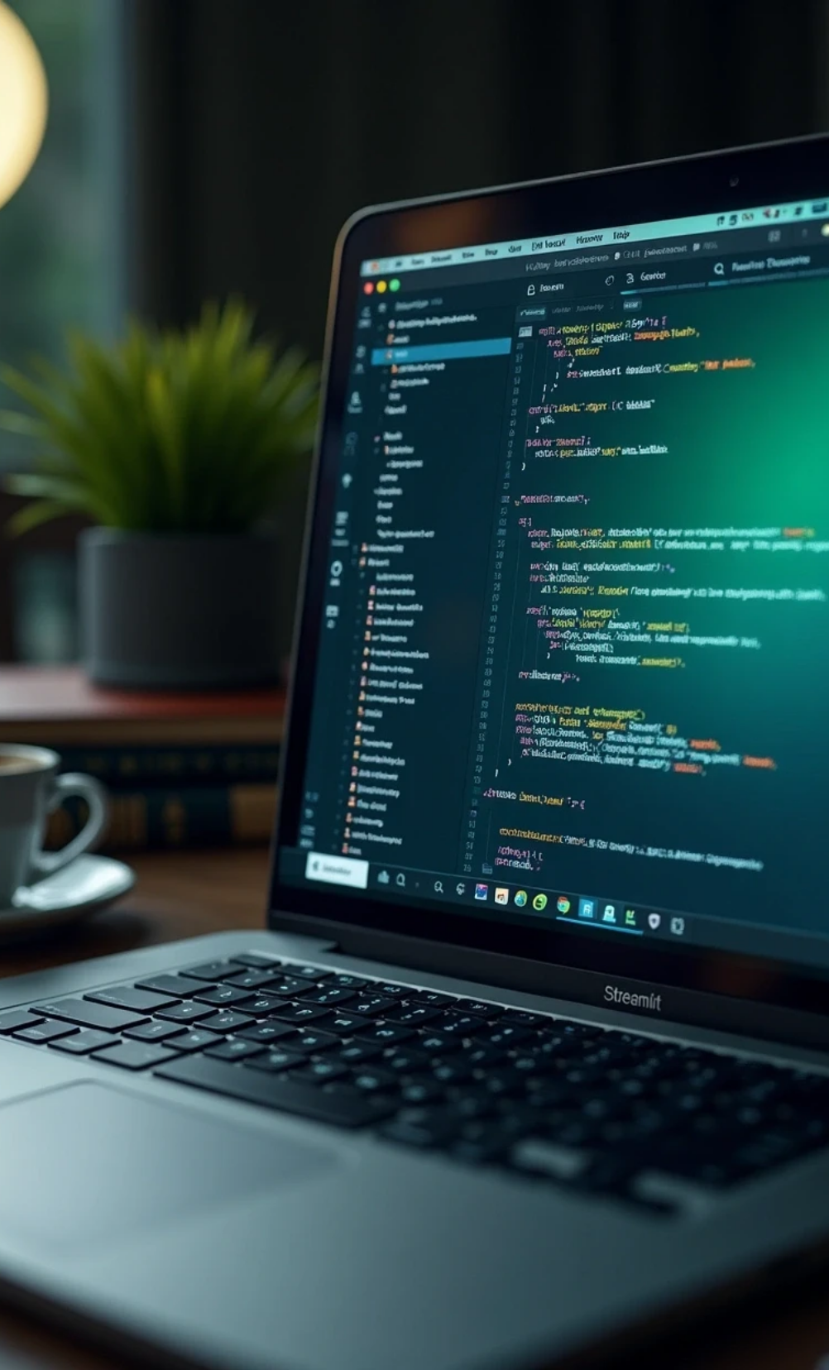




Tools Used
1
Frontend Technologies
• Streamlit: Used for building the web application interface.
2
Backend Technologies
• Hugging Face Transformers: For advanced natural language processing tasks.
• NLTK VADER: For sentiment analysis and bias scoring.
3
Utilities
• Custom utilities: Functions for text wrapping and splitting sources.

Slide 8

03
Implementation Workflow

Slide 9
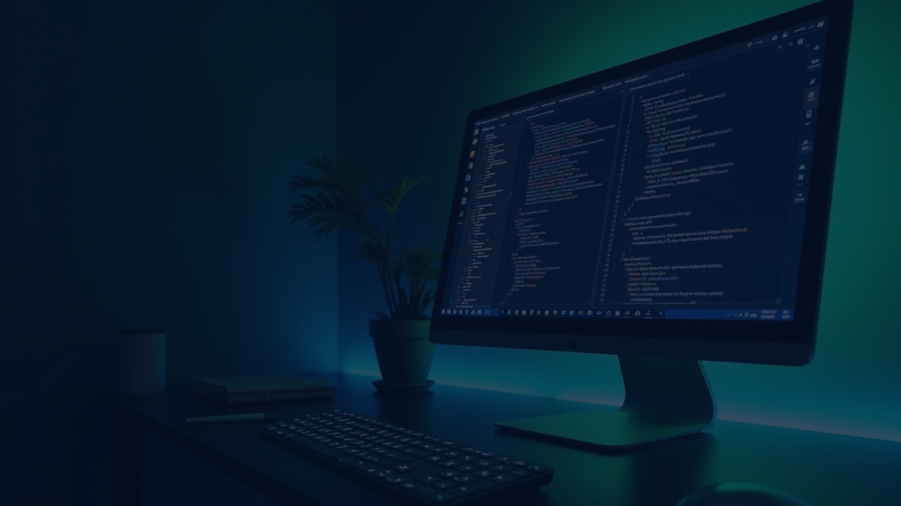
Code Explanation
The main code structure is as follows:
import streamlit as st from utils import wrap, split_sources from scrape import extract_multiple from summarizer import summarize from bias import score_bias, compare_sources st.set_page_config(page_title="D8 News Summarizer & Bias Detector", layout="wide") st.title("📰 D8 News Summarizer & Bias Detector") st.markdown(""" Paste **one or more URLs** *(one per line)* **or** paste raw article text (separate multiple articles with a line `---`). """) col1, col2 = st.columns([1,1]) with col1: urls_raw = st.text_area("URLs (one per line)", height=180, placeholder="https://example.com/news-1nhttps://example.com/news-2") with col2: pasted = st.text_area("Or paste article text (use `---` line to split multiple)", height=180) tone = st.selectbox("Summary tone", ["neutral summary", "fact-only", "explain to a 10-year-old"]) use_gemini = st.toggle("Prefer Gemini (if API key configured)", value=True) max_words = st.slider("Max summary length (words)", 80, 300, 140, 10) if st.button("Summarize & Detect Bias", type="primary"): urls = [u.strip() for u in urls_raw.splitlines() if u.strip()] sources = [] texts = [] if urls: rows = extract_multiple(urls) for src, txt in rows: sources.append(src) texts.append(txt) if pasted.strip(): for part in split_sources(pasted): sources.append("pasted") texts.append(part) if not texts: st.warning("Please provide at least one URL or paste article text.") st.stop() summaries = [] biases = [] for src, txt in zip(sources, texts): s = summarize(txt, tone=tone, max_words=max_words, prefer_gemini=use_gemini) b = score_bias(txt) summaries.append((src, s)) biases.append(b) comp = compare_sources(texts) for i, ((src, summ), b) in enumerate(zip(summaries, biases), start=1): st.subheader(f"Source {i}: {src}") st.write("**Summary:**") st.write(wrap(summ or "_(no summary)_", width=100)) st.write("**Bias signals:**") c1, c2, c3, c4 = st.columns(4) c1.metric("Overall", b.label) c2.metric("VADER", f"{b.vader:+.3f}") c3.metric("HF Label", b.hf_label) c4.metric("Charged word ratio", f"{b.charged_ratio:.4f}") st.markdown("---") st.subheader("Across-source comparison") st.write(f"Disagreement (VADER std-dev): **{comp['disagreement']:.3f}** — higher means sources differ more in tone.") else: st.info("Enter URLs or paste text, choose a tone, then click **Summarize & Detect Bias**.") st.caption("Streamlit • Hugging Face Transformers • NLTK VADER • (optional) Gemini")

Slide 10

04
Challenges Faced

Slide 11
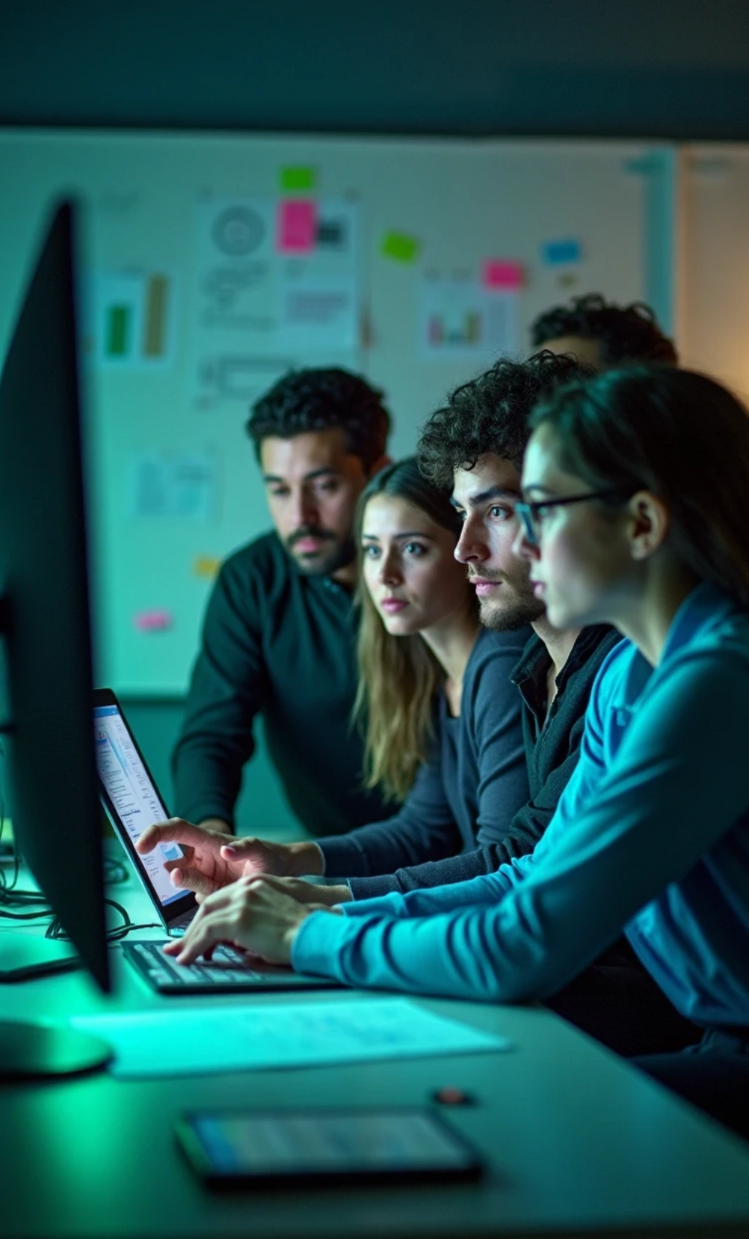


Challenges Faced
1
Technical Challenges
• Integrating multiple APIs for text extraction and summarization.
• Ensuring accurate bias detection across different sources.
2
User Experience Challenges
• Designing an intuitive interface for users with varying levels of technical knowledge.
• Providing clear instructions for input formats.

Slide 12
05
Conclusion

Slide 13
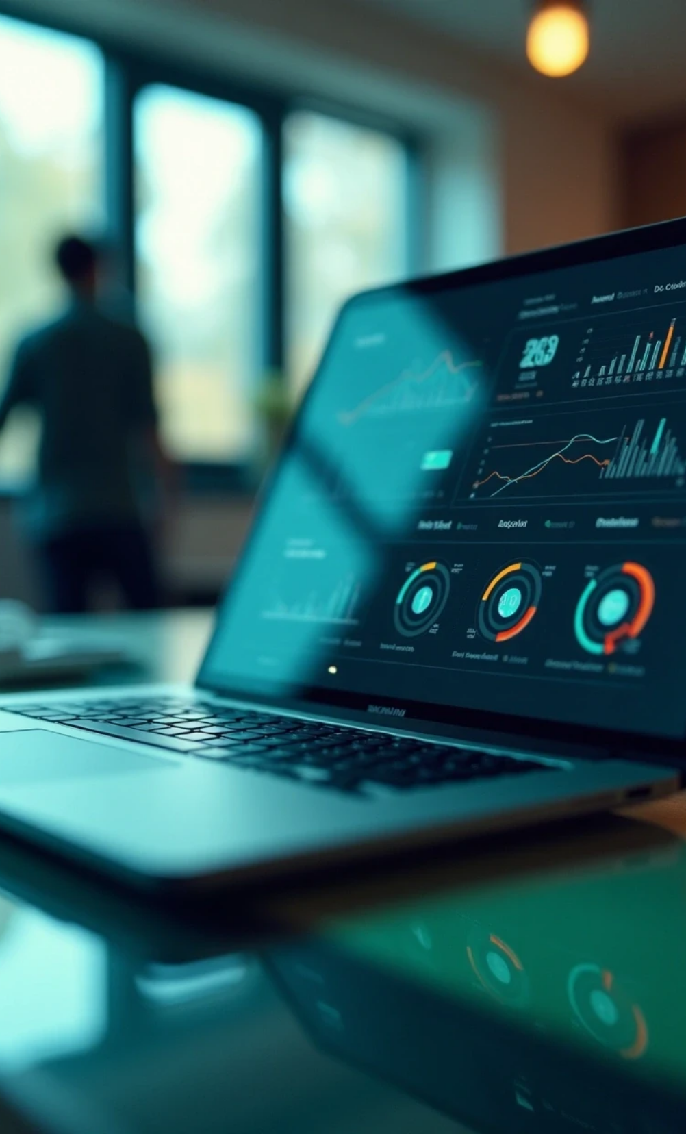
Conclusion
This project successfully combines summarization and bias detection in a single tool. It leverages modern technologies to enhance user experience and provides valuable insights into the news content consumed by users.

Slide 14

Future Improvements
Enhance bias detection algorithms.
Expand the range of sources supported for input.
Improve user interface design for better accessibility.

Slide 15

Thank You

